Slide 1
Abandoning Coffee under the Threat of Violence and the Presence of Illicit Crops. Evidence from Colombia.
Ana María Ibáñez Londoño
Juan Carlos Muñoz Mora
Philip Verwimp
ECON 541
Lauren Coker

Slide 2
Motivation
Explore the importance of the risk of violence due to internal conflict and the presence of illicit crops on agricultural decisions of rural households in Colombia
Previous research shows:
Households modify their consumption and production decisions in order to prevent or mitigate the impacts of conflict
Conflict generates incentives for households to switch from traditional agricultural activities to illicit crop cultivation
The presence of illegal activities intensifies criminal violence, weakens the judicial system and becomes an obstacle to end the conflict
Objective is to provide evidence on the costs of conflict and to show how conflict modifies the returns to illegal crops.

Slide 3
Background
Coffee emerged as the main export product of Colombia
Support provided by the FNC was crucial to consolidate coffee and promote economic development in coffee regions
The emergence of drug traffickers fueled local conflict by providing resources to fund guerrilla groups in the late 1960s
Conflict regions became ideal scenarios for the expansion of illicit crops cultivation
1989 the International Coffee Agreement collapsed
Traditional coffee regions were exposed to more risk, such as violence and the presence of illicit crops
In 2001 coffee prices fell to the lowest levels in 180 years
Coca cultivation in traditional coffee regions began growing in 2002, a year after the coffee crisis in 2001, which may have prompted some coffee growers to shift from coffee production to coca cultivation

Slide 4
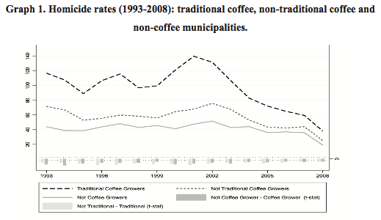
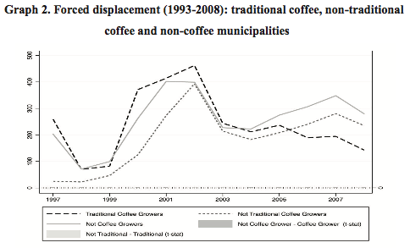
Background (cont.)

Slide 5
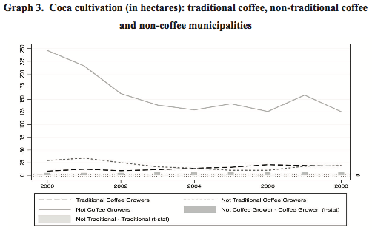
Background (cont.)

Slide 6
Estimation Strategy
Probability to continue coffee production
Percentage of farm cultivated in coffee
Captures violent shocks at the municipality level
Proportion of municipal hectares allocated to coca production
Exclusion restriction vector
Vector of initial characteristics of households and land plots from the CCG93/97 census
A vector of municipality controls, including land quality (UAF)11 and altitude (meters above sea level)

Slide 7
Data
Census of Coffee Growers/Coffee National Information System (SICA)
Used panel data set of coffee growers from 1993-1997 census
Data collected by FNC via questionnaire to 664 coffee growers. Questionnaire captured:
Land plot size
Size of the land allocated to coffee production and other crops
Physical characteristics of the coffee trees (Number, age, seed type)
Collected victimization data at the household level using aggregated municipality level data provided by CEDE (Centro de Estudios del Desarrollo)
Used this data to:
Examine the direct impact of conflict on agricultural production through the change of the percentage of the farm allocated to coffee
Explore how conflict generates incentives to substitute legal agricultural production for illegal crops using the farmers that dropped out between the data sources

Slide 8
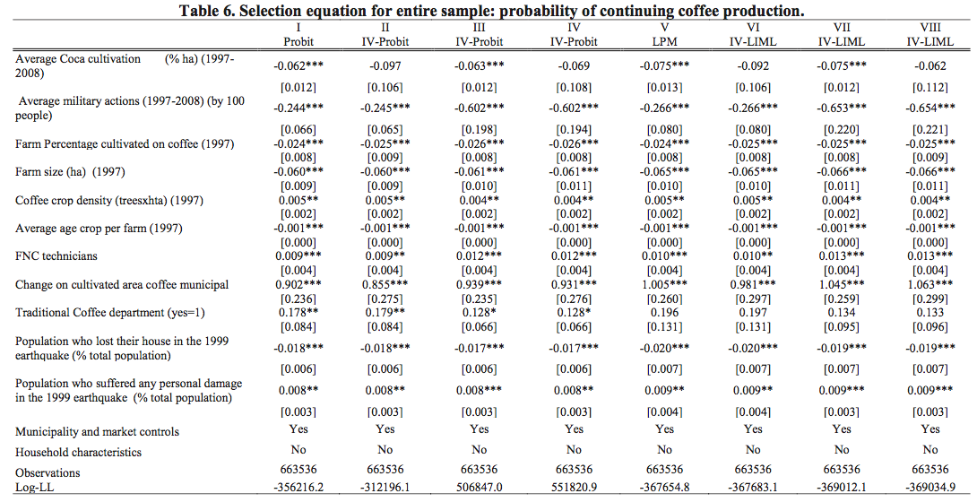
Results

Slide 9
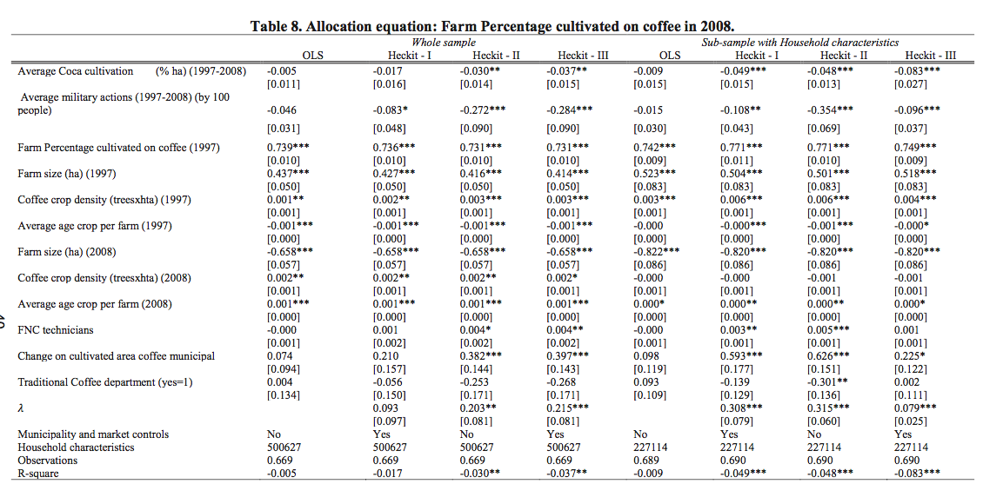
Results

Slide 10
Conclusion
The risk of violence and the presence of illegal crops have a significant impact on the decision to continue coffee production and on the percentage of the farm allocated to coffee in 2008.
Coffee growers are more likely to drop out of coffee when they are exposed to high risks of violence and the presence of illegal crops
Although the FNC was able to keep coffee growers isolated from conflict for many years, the coffee market crises, the increase of violence and the rise of coca crops in Colombia in the late 20th century generated an unfavorable environment for coffee cultivation which resulted in a reduction in coffee production.
Accessibility to credit and insurance will also have an impact on crop allocation and is not controlled for in the data.
What were some of the other reasons that coffee growers in the census data continued production?
Critique

